Slide 1


Building Trust in Fintech: DevSecOps Strategies at Saxo Bank
Jinhong Brejnholt
Chief Cloud Architect
jbrejnholt

Slide 2
Astruct
At Saxo Bank, the cornerstone of our trading platform's integrity is our DevSecOps approach, which ensures top-tier security and code quality. This talk will highlight our security gates that empower developers to produce secure code from the get-go and govern our platform's continuous evolution. We'll delve into our 'shift left' strategy, which integrates security early in the development process for rapid feedback and enhanced efficiency. Discover how these practices enable us to maintain a secure, reliable, and trustworthy trading environment for our customers and partners.

Slide 3




3
jbrejnholt

Slide 4
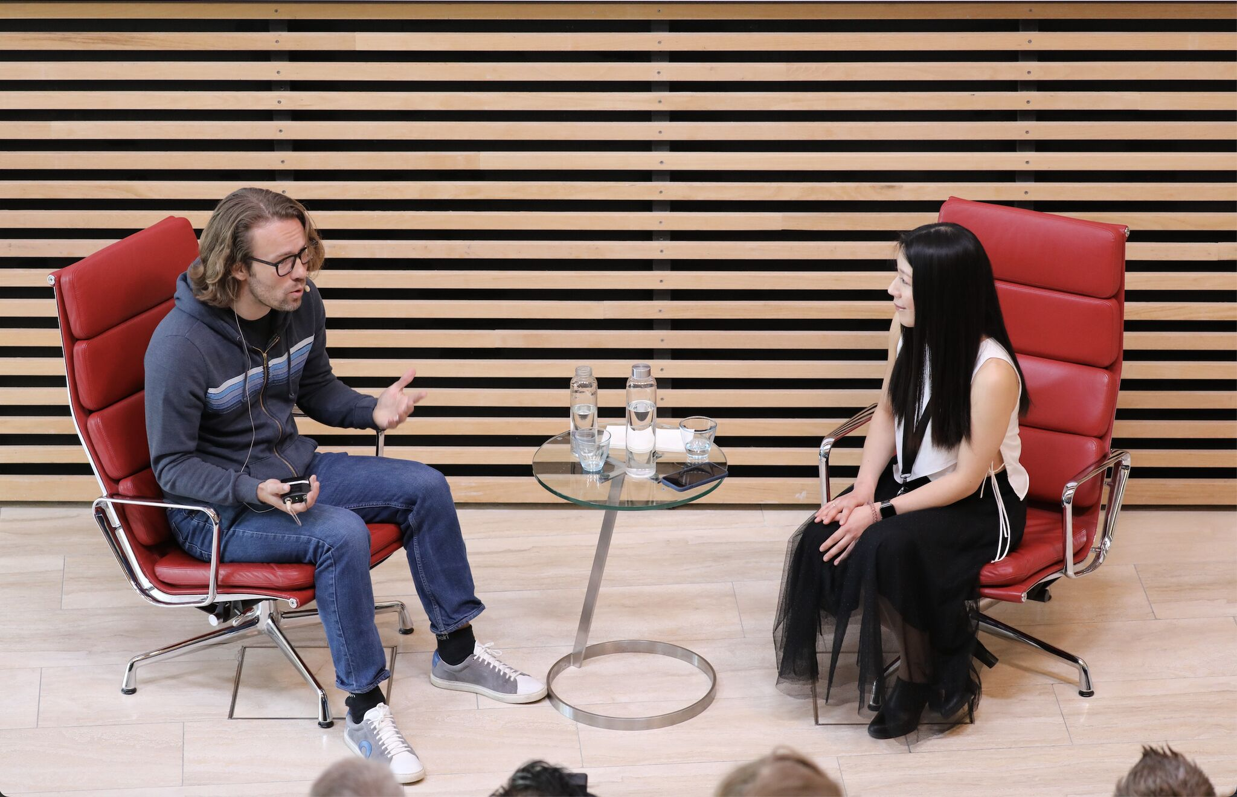
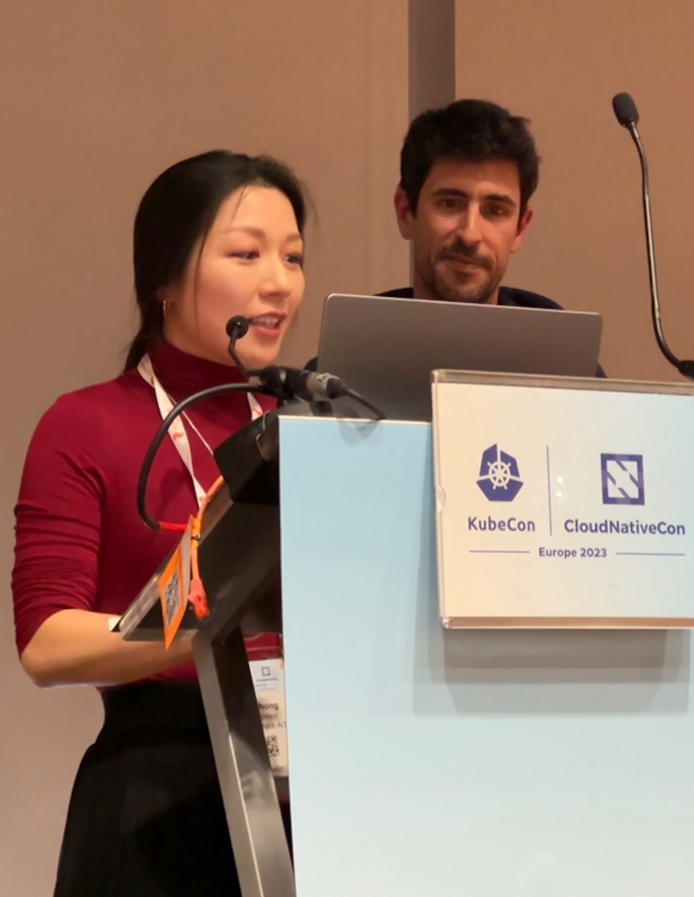
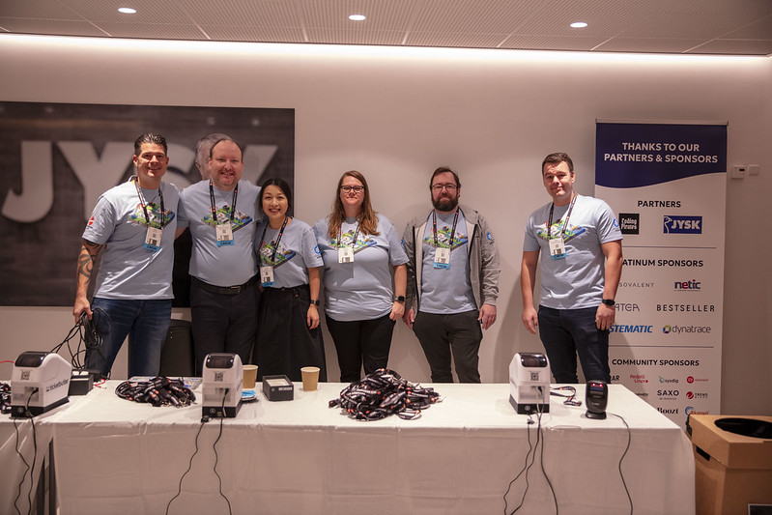
Cloud Native Community
Tuesday, February 2, 20XX
jbrejnholt
23 May 2024

Slide 5

About Saxo
Online trading and investment
17 billion USD daily trade
200+ banks and brokers
1 million clients
DKK 800 billion (USD 116.1 billion) in client assets
5
jbrejnholt
Notes:
“Saxo Bank is a very different bank, and we want our environment to reflect that. The T-Rex that hangs in the canteen reminds us that we need to remain agile and be on the leading edge of technology developments so that we can continue to help our clients and partners navigate the global markets. In other words, we cannot become dinosaurs.” --Kim Fournais, CEO and Founder, Saxo Bank
Saxo Bank is a Danish investment bank specializing in online trading and investment. It was founded as a brokerage firm in 1992, under the name Midas Fondsmæglerselskab, by Lars Seier Christensen, Kim Fournais, and Marc Hauschildt. The name was changed to Saxo when the company obtained a banking license in 2001.
Saxo Bank A/S is a fully licensed and regulated Danish bank with an online trading platform that empowers you to invest across global financial markets.

Slide 6

Trust
6
jbrejnholt

Slide 7
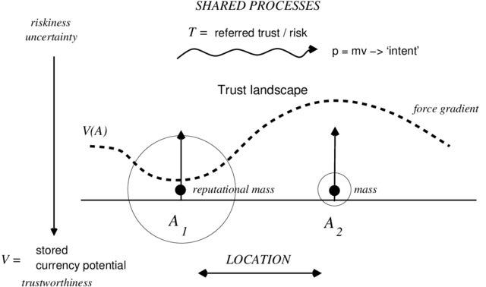
Trust is measurable
jbrejnholt
Notes:
Consistency - How reliably someone behaves over time.
Transparency - How open and clear someone is about their actions and intentions.
Alignment of Interests - How well someone's goals align with yours.
Medium
Trust and Trustability
How Promise Theory tells us trust is really an economy of attention

Slide 8
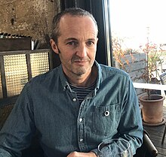
Trust
Trust as a prediction about someone's behavior based on their past actions, reliability, and intentions.
Trust is built over time through consistent and predictable behavior.
Mark Burgess
Independent researcher and writer. Formerly professor at Oslo University College.
Known for Promise Theory.
jbrejnholt
Notes:
Medium
Trust and Trustability
How Promise Theory tells us trust is really an economy of attention

Slide 9

Slido – two questions
https://admin.sli.do/event/auZ9YFS23QxkKuHgM8aVuz/polls
Vote at Slido.com
with #2020022
9
jbrejnholt

Slide 10

Trust Before Invest
10
jbrejnholt

Slide 11
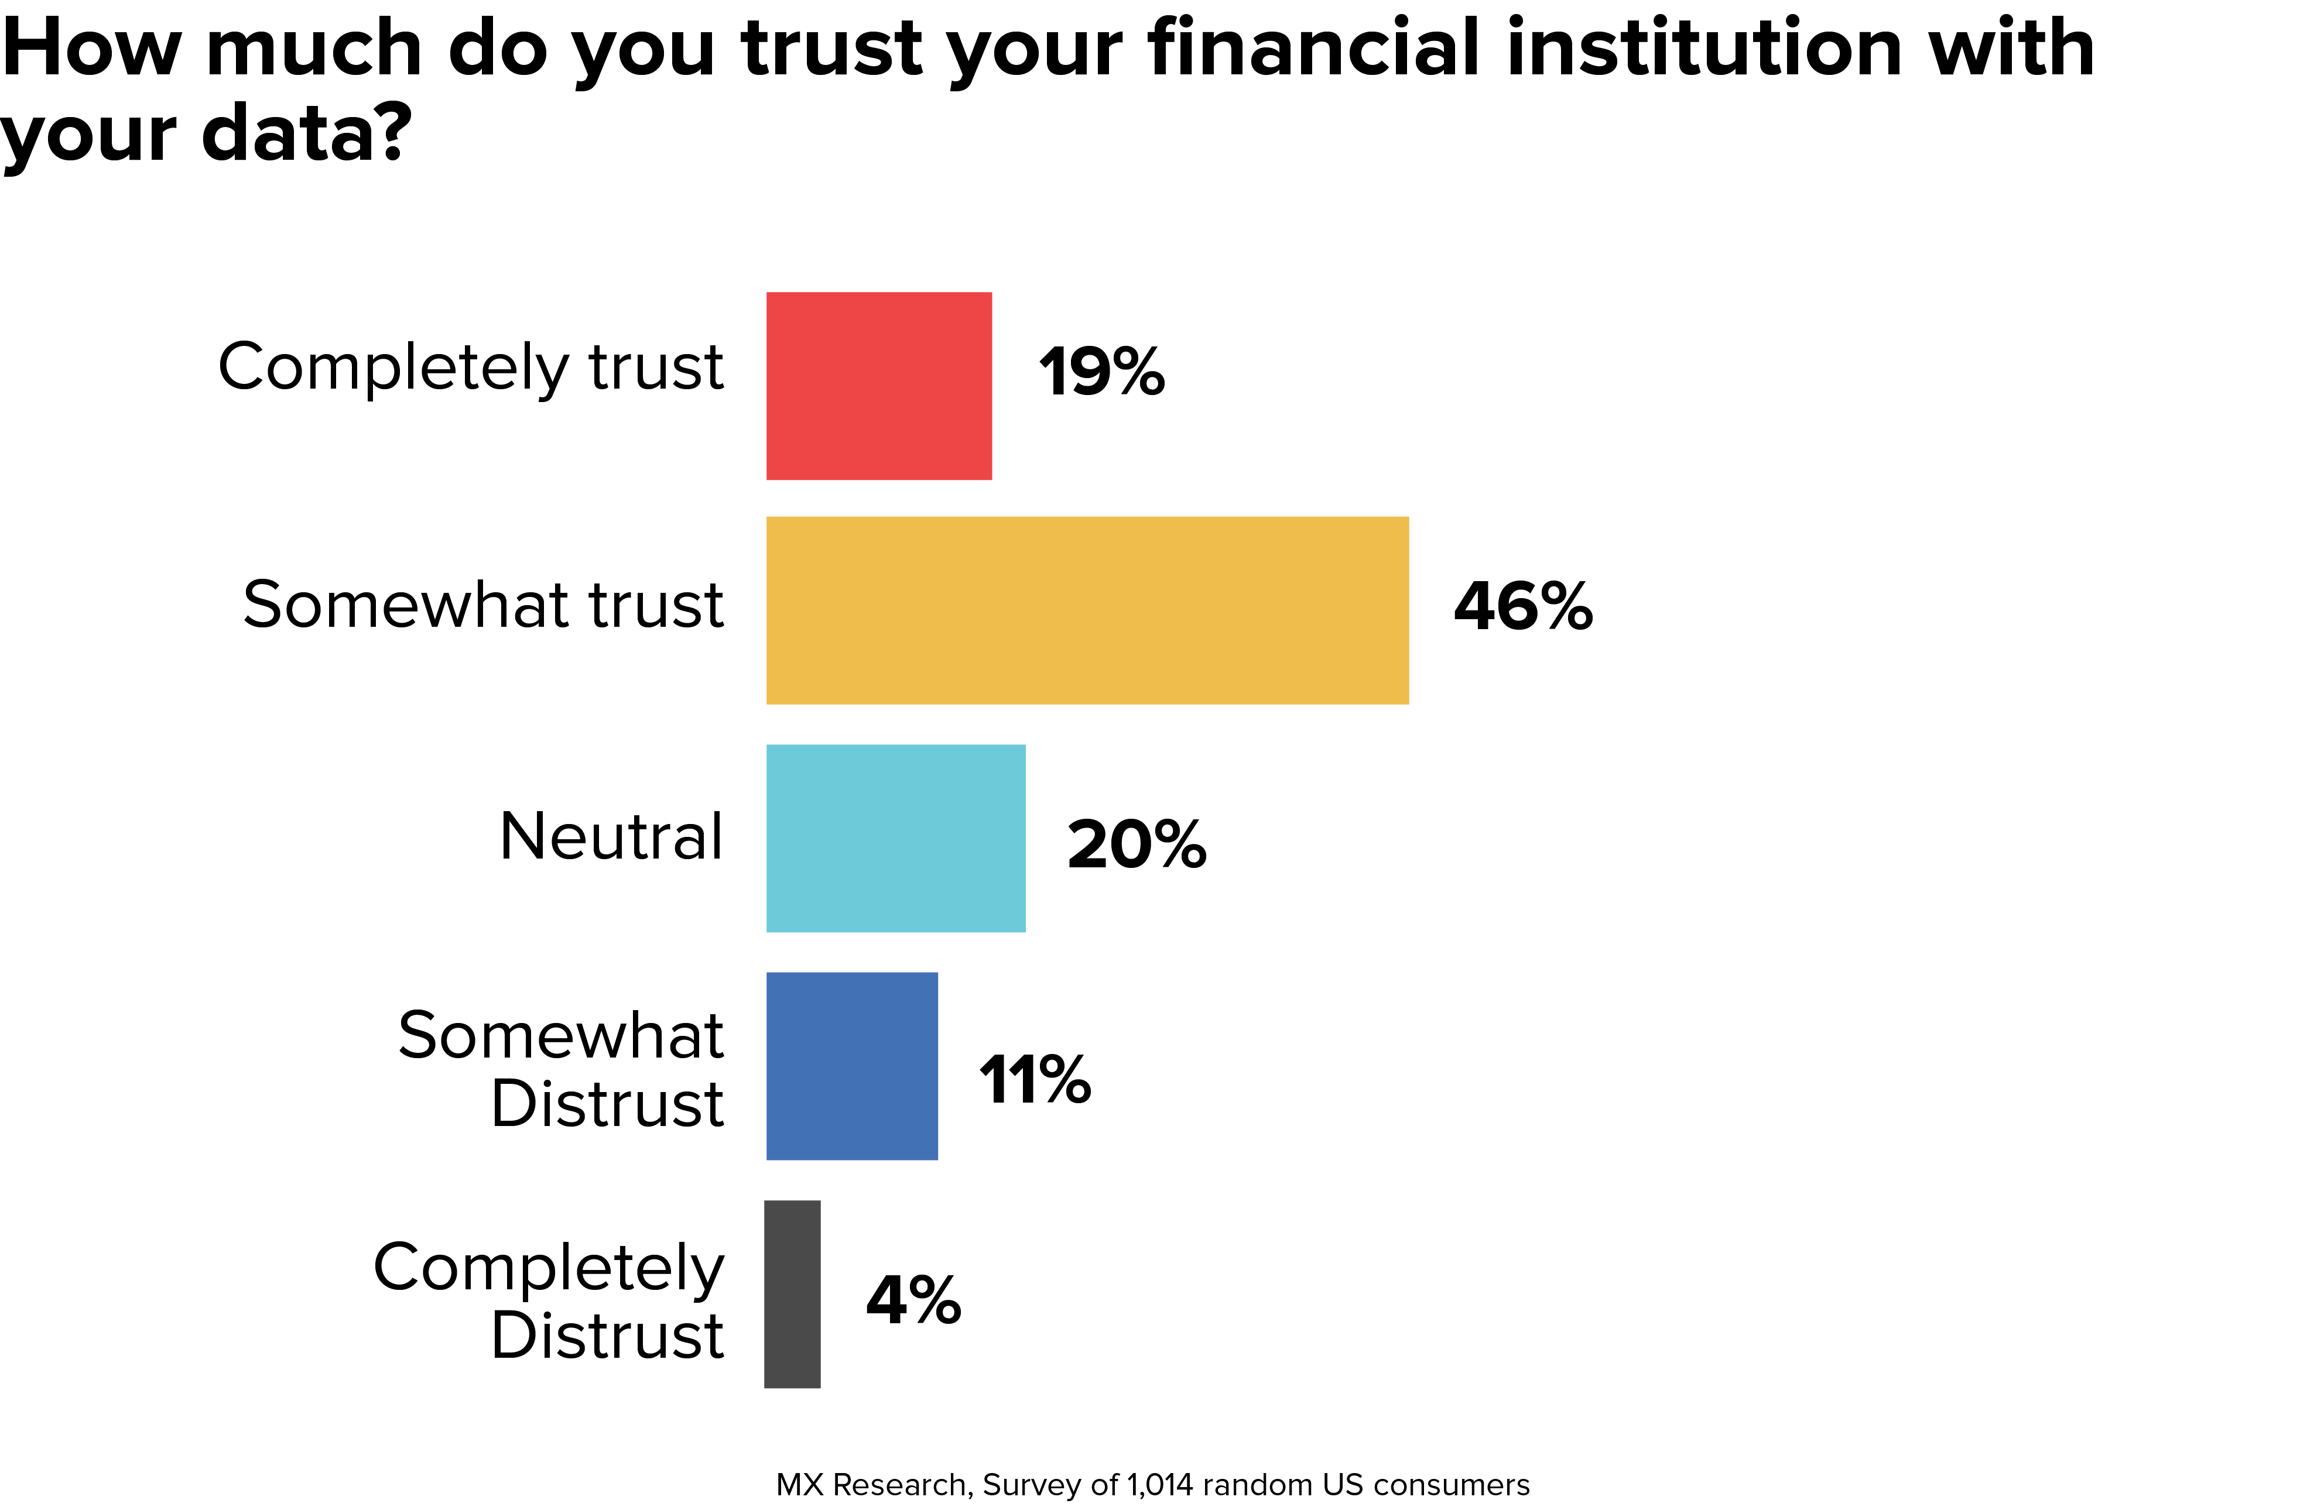
jbrejnholt

Slide 12
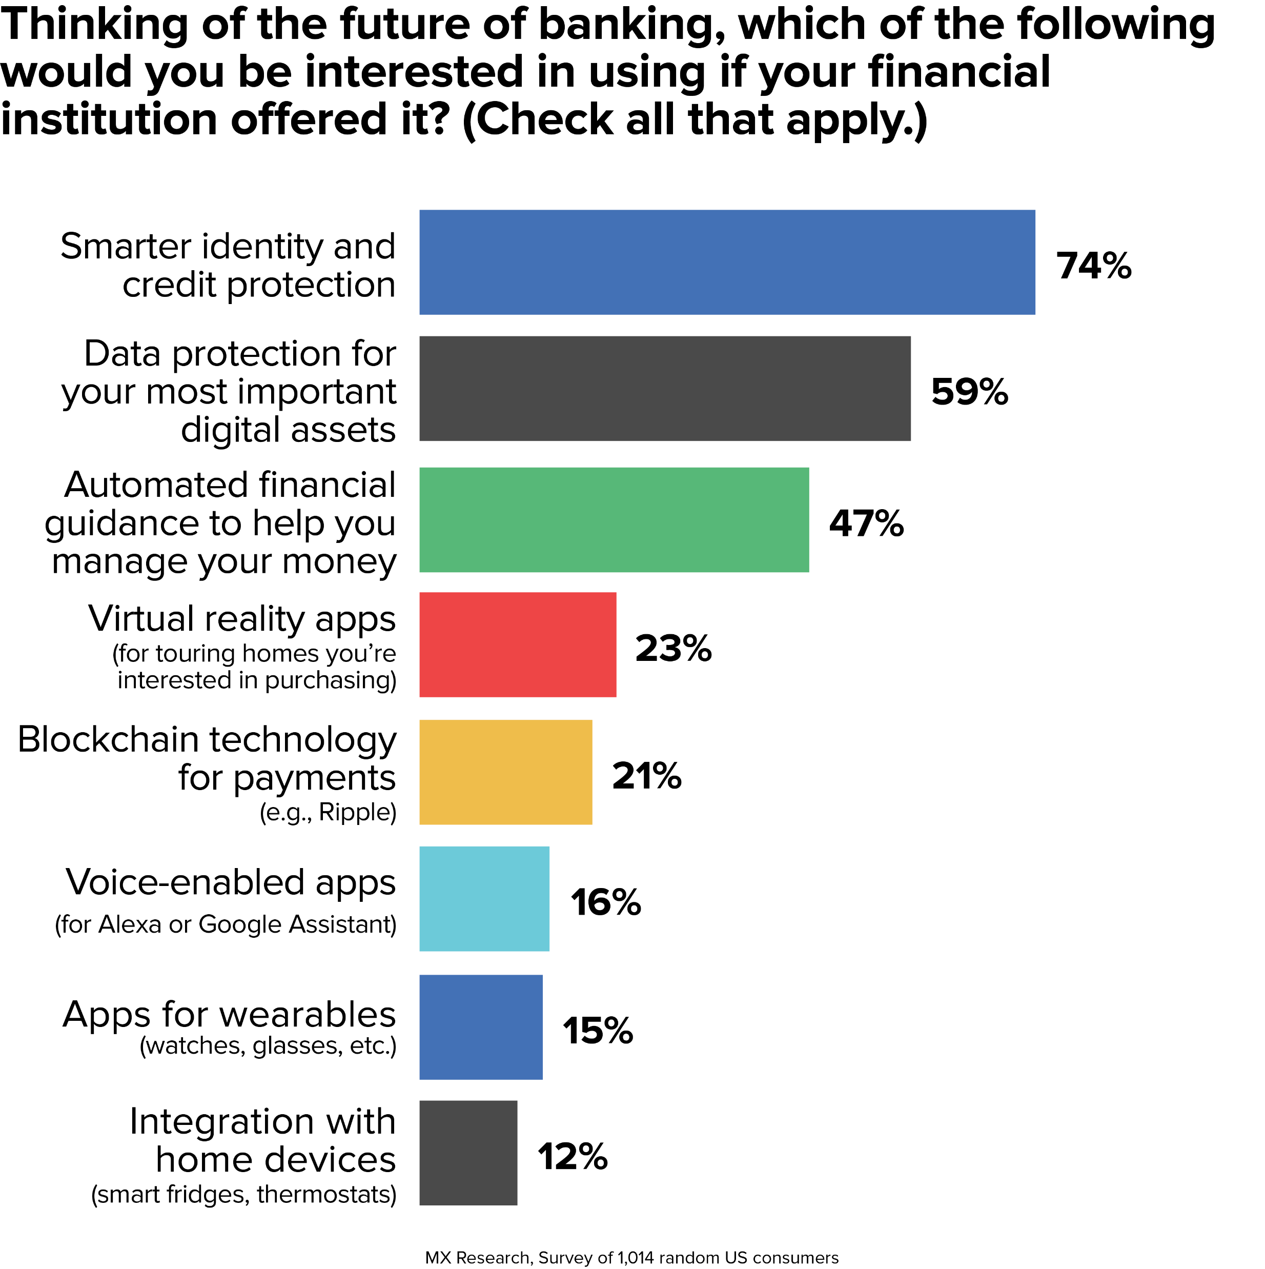
12
jbrejnholt

Slide 13


13
jbrejnholt
Notes:
As an investment bank, we would like to offer the best services – securely
Good product platform is great – but most importantly - security

Slide 14
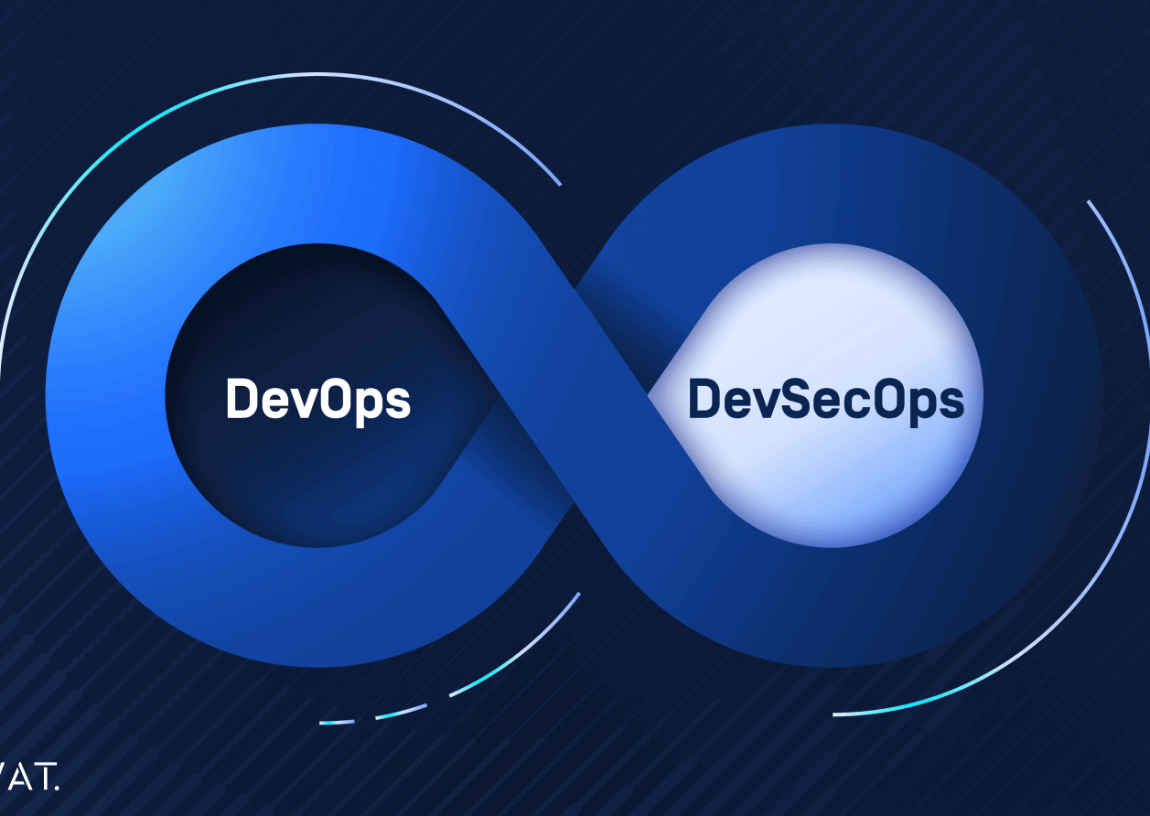
DevSecOps
Development, Security, and Operations, is a framework that integrates security into all phases of the software development lifecycle.
14
jbrejnholt
Notes:
Organizations adopt this approach to reduce the risk of releasing code with security vulnerabilities.
Through collaboration, automation, and clear processes, teams share responsibility for security, rather than leaving it to the end when issues can be much more difficult and costly to address.

Slide 15
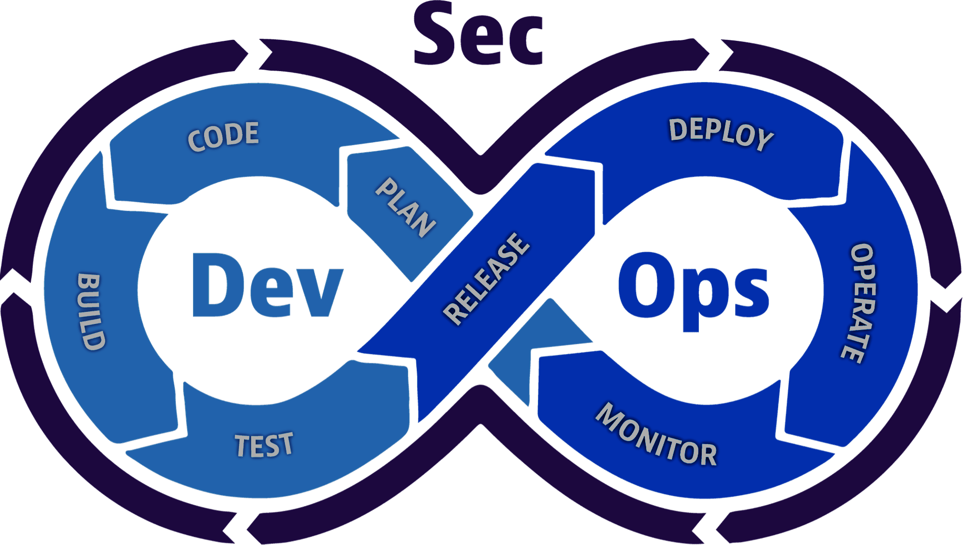
DevSecOps
jbrejnholt
Notes:
Continuous integration
Continuous delivery
Continuous security
Communication and collaboration

Slide 16
DevSecOps
One Step beyond DevOps
jbrejnholt
Notes:
Continuous integration
Continuous delivery
Continuous security <- New
Communication and collaboration

Slide 17
The ratio challenge
Dev : Ops : Sec
200 : 5 : 1
17
jbrejnholt
Notes:
We are a bank – but we can’t print our own money
We are facing the same security and compliance challenge through out the Software development lifecycle as everyone else

Slide 18
Main Steps
Build
Deploy
Run
jbrejnholt

Slide 19
Build
Build
Deploy
Run
Internal
External
Code Quality
Test Coverage
Vulnerabilities Management
License Compliant
jbrejnholt

Slide 20
Deploy
Build
Deploy
Run
Vulnerabilities
Change Process
Security & Best Practices
Artifact Integrity
License
jbrejnholt

Slide 21
Run
Build
Deploy
Run
Vulnerabilities
Policies Enforcement
Behavior Monitoring
License
jbrejnholt

Slide 22
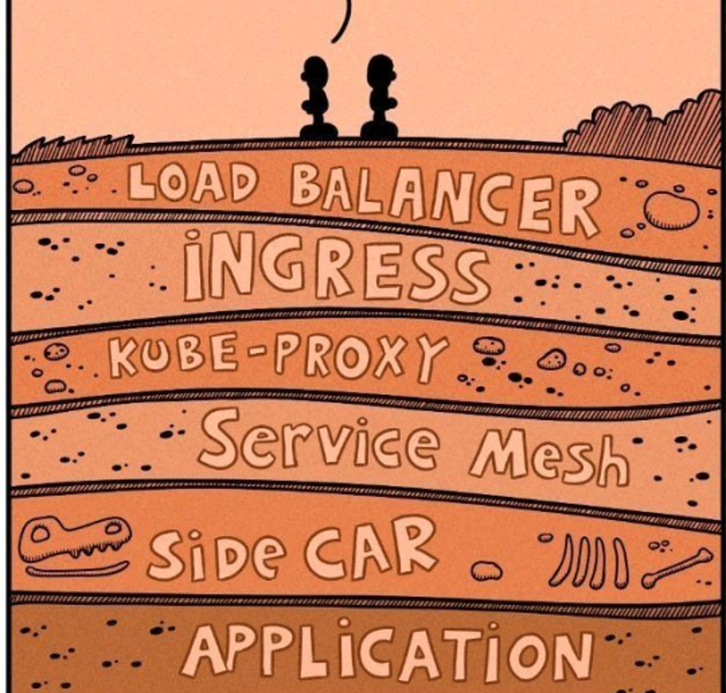
The story doesn’t just end here
22
jbrejnholt

Slide 23
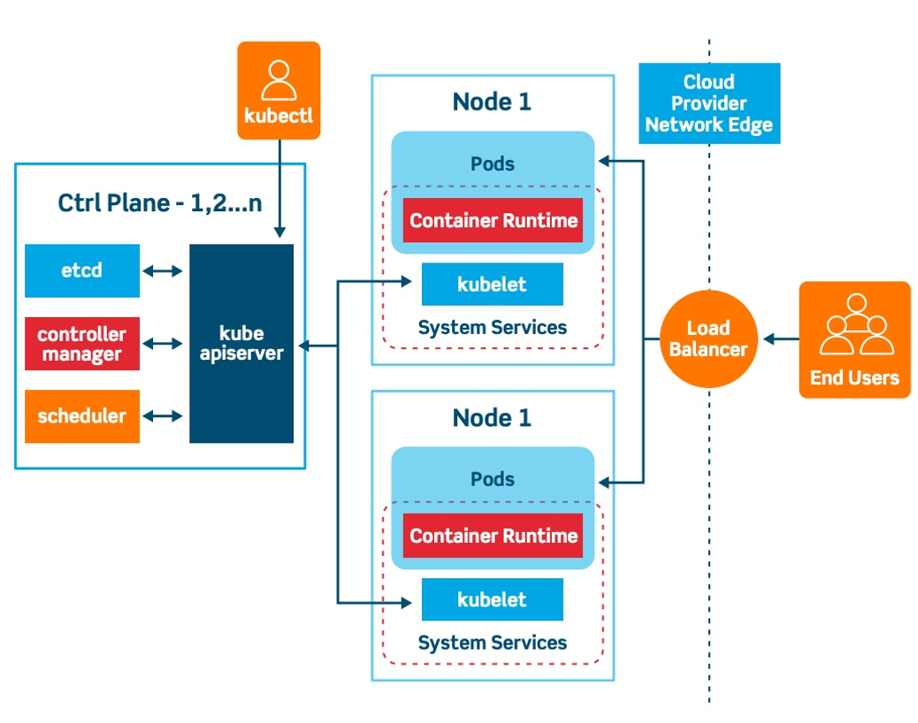
Complex tech stack
jbrejnholt

Slide 24
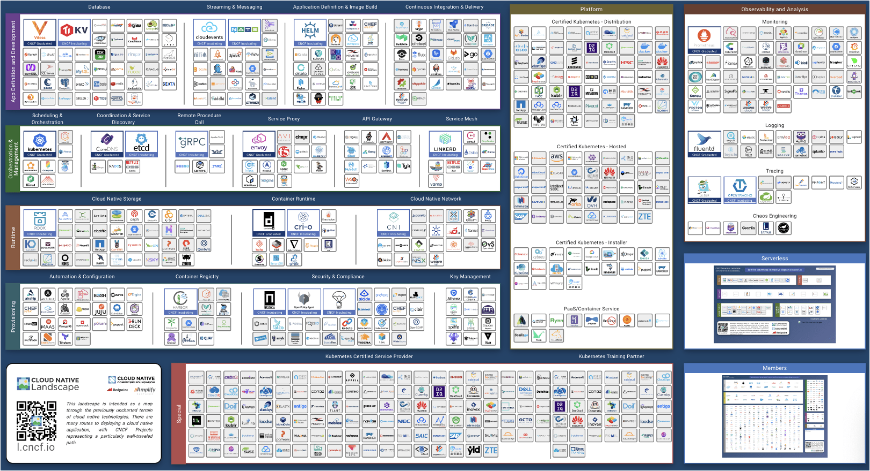
24
jbrejnholt

Slide 25
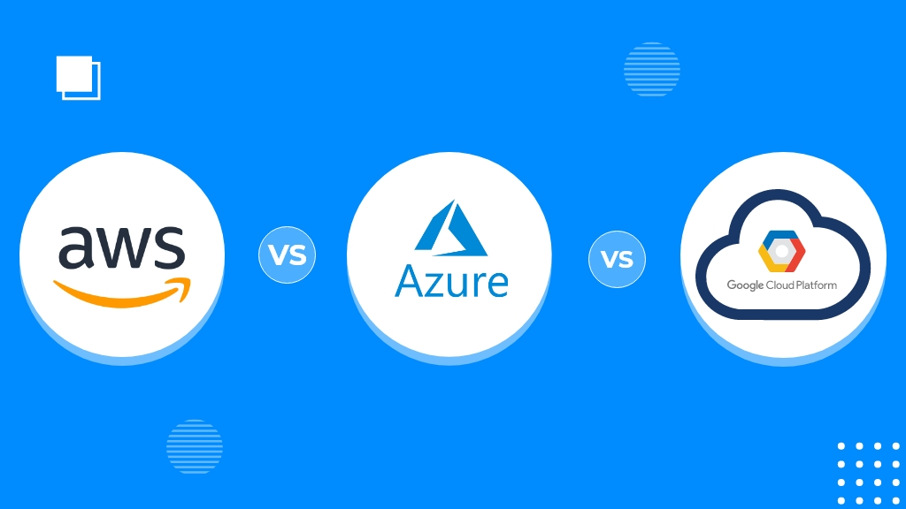

Managed Services
200+
200+
100+
25
jbrejnholt

Slide 26
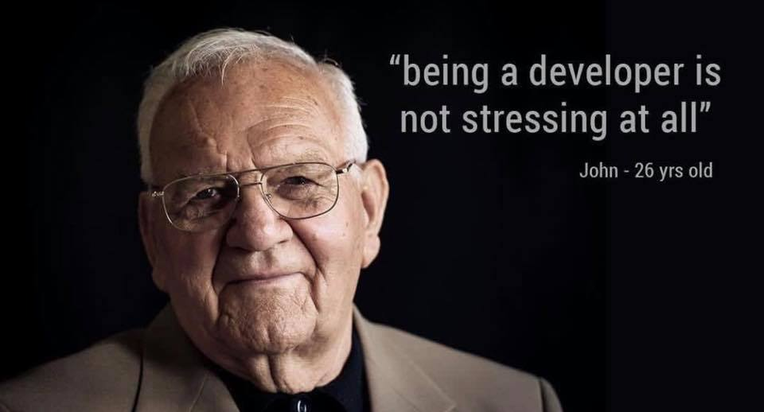
26

Slide 27

Stack Overflow’s 2020 Developer Survey
Source: https://survey.stackoverflow.co/2020
65K developers
15% - anxiety, depression, or another mental issue
83% of developers report burnout
jbrejnholt

Slide 28

DevSecOps?
28
jbrejnholt
Notes:
You might think – hey, I thought we were talking about DevSecOps?

Slide 29

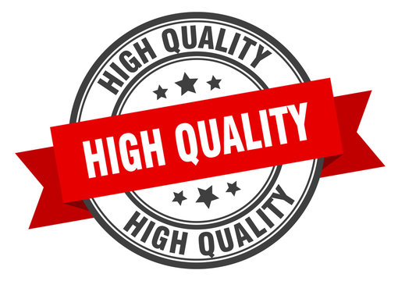
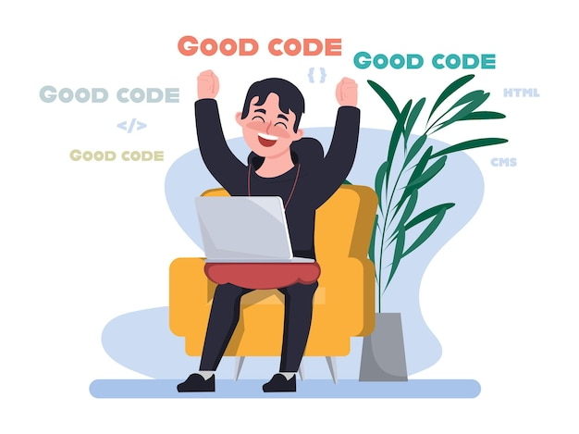
29
jbrejnholt
Notes:
Yep!

Slide 30

Built-in Security
Build
Deploy
Run
jbrejnholt
Notes:
Security as part of the platform offering

Slide 31


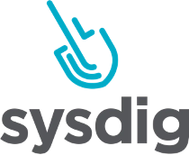


Build
Build
Deploy
Run
Internal
External
Code Quality
Test Coverage
Vulnerabilities Management
License Compliant
jbrejnholt

Slide 32



Deploy
Build
Deploy
Run
Vulnerabilities
Change Process
Security & Best Practices
Artifact Integrity
License
jbrejnholt

Slide 33




Run
Build
Deploy
Run
Vulnerabilities
Policies Enforcement
Behavior Monitoring
License
jbrejnholt

Slide 34



DevSecOps
Shift Left
Build
Deploy
Run
jbrejnholt
Notes:
Faster delivery
Improved security posture and integration
Reduced costs
Better product – better trust

Slide 35




DevSecOps
Shift Right
Build
Deploy
Run
jbrejnholt
Notes:
Production is where most attacks happen.
Scanning source code can’t give you the same rich insights you can get by observing the application when it is running in production.
Some applications you run in production may not have run through your dev environment, so they never had a chance to be scanned by security tools in your dev environment.
To detect new zero-day vulnerabilities, you need to monitor existing applications in your production environment.

Slide 36

Celebrate?
36
jbrejnholt

Slide 37

Continue Evaluating and Improving
jbrejnholt

Slide 38
Our Recommendations – TOBE Deleted
Built-in security checks, policy as code
Continue upskilling developers and platform engineers
Practice chaos engineering
Start small, and constantly improving
Automation, Automation, Automation
Notes:
1. Built-in security checks, policy as code
2. Continue upskilling developers and platform engineers
3. Practice chaos engineering
4. Start small, and constantly improving
5. Automation * 3

Slide 39

Our Recommendations
Built-in security checks, policy as code
Continue upskilling developers and platform engineers
Practice chaos engineering
Start small, and constantly improving
Automation, Automation, Automation
jbrejnholt
Notes:
1. Built-in security checks, policy as code
2. Continue upskilling developers and platform engineers
3. Practice chaos engineering
4. Start small, and constantly improving
5. Automation * 3

Slide 40

Thank You
jbrejnholt
Notes:
CPH

